Slide 1

Apple social media analytics for strategic branding.

Slide 2
Aim :
A thorough data analysis across different platforms to help Apple’s Marketing team align content performance with expected business outcomes.

Slide 3




Business Objectives
Strengthen Apple’s Global Identity
Increase Customer Engagement
Increase Reach of New Innovations
Maximize Digital and Influencer ROI

Slide 4
Questions to answer :
Which Type of Content campaign resonates most with Apple’s Audience?
How Ad Spend and Campaign Engagement contribute to ROI?
How Launches affect Follower Growth and Engagement?
What Customer Strategy sustains Customer Loyalty and Brand Advocacy?

Slide 5
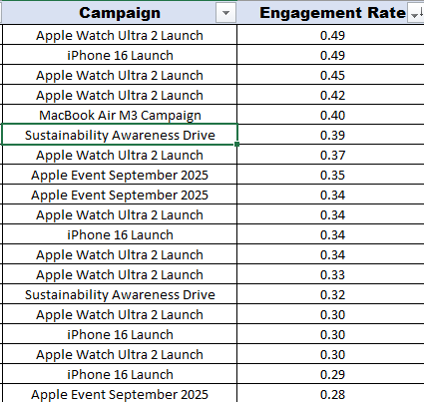
Question 1
As we can see the in this picture, the Content Campaign that resonates most with Apple’s Audience are –
Apple Watch Ultra 2 Launch(Health & Fitness)
Iphone 16 Launch(Product Launch)
Macbook Air M3 Campaign(Promotion)

Slide 6

Question 2
As seen in the above graph, Ad spend is not directly correlated to ROI, as campaigns with smaller budgets can also be seen delivering stronger ROI. Thus, the focus should be more on uplifting engagement rates to get higher ROI.

Slide 7
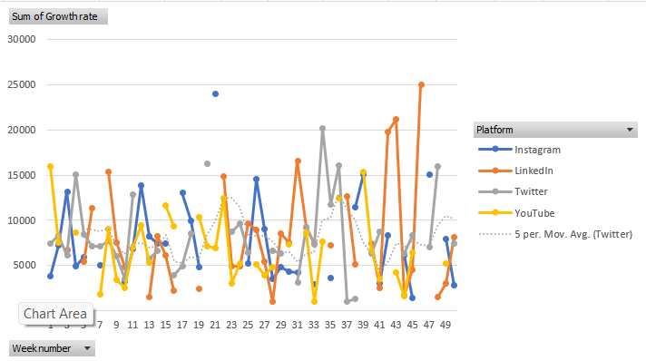
Question 3
Product Launches drive spikes in follower growth rate, as seen in the graph some of the top performing weeks are product launch weeks. This indicates that Product Launches act as a catalyst in boosting follower growth and engagement.

Slide 8
Health & fitness campaigns and product launch campaigns significantly strengthen brand advocacy by reinforcing brand relevance and trust. Platform-specific, relatable content further enhances audience engagement by aligning with how users consume content across channels.
QUESTION 4
Youtube | Videos - Health and Fitness and sustainability Branding ads
Instagram | Videos(Reels) - Health and Fitness and sustainability, increase engagement on Images
Twitter | Videos for Reach(need to work on making the content relatable for the audience to engage w it more)
 | and images for engagement - need to work on increasing their reach
LinkedIn | Videos for Positive Health Benefits posts.

Slide 9

insights
Apple’s audience responds most strongly to Health & Fitness and Product Launch campaigns
Ad spend does not directly determine ROI. Increasing engagement uplift is the primary lever for improving ROI.
Product launches act as clear growth catalysts
Health & fitness and launch-driven campaigns reinforce brand relevance and trust, while relatable, platform-specific content sustains customer loyalty and strengthens long-term brand advocacy.

Slide 10


